Slide 1
Using the Linux Servers
Code Camp Week 2

Slide 2

What are they?
The Linux servers are a bunch of machines that are running the Linux operating system
They have software that is useful and necessary for UCLA computer science courses
Professors test student code using these servers

Slide 3
Software Used
On Windows
On Mac
Need to download Putty
Used to login to the server
Optional download: WinSCP
Used to transfer files to/from the server
Use the Terminal app to login to the server
Optional download: Cyberduck
Used to transfer files to/from the server

Slide 4
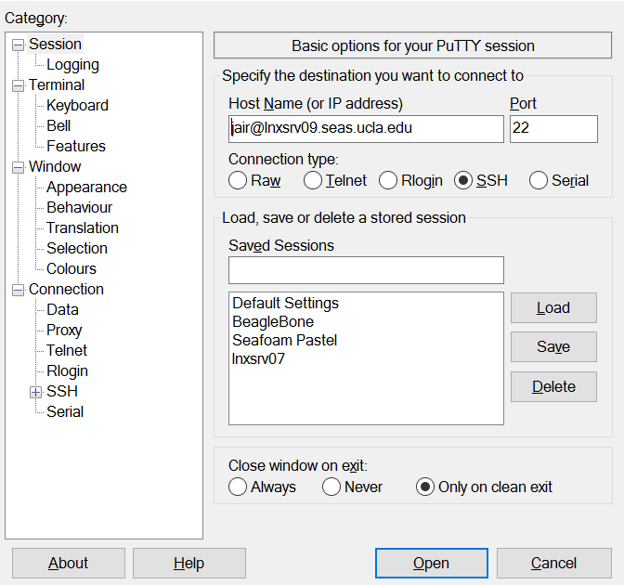

Signing In: Windows
SEASnet username
Name of the server

Slide 5
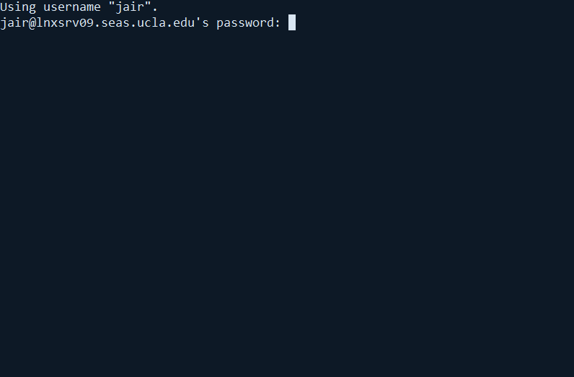
Signing In: Windows
Type in your SEASnet password
If no characters appear, don’t worry, that is normal
Hit enter when you are done

Slide 6
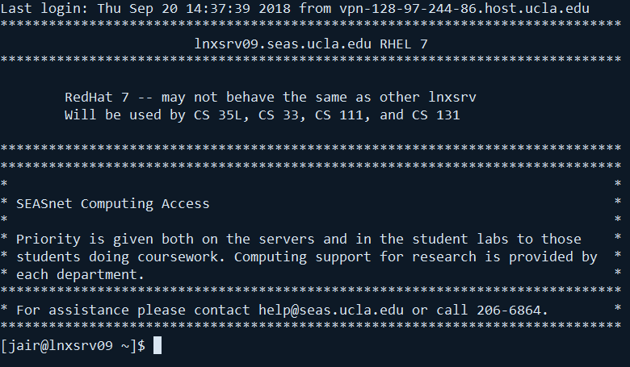
Signing In: Windows
If you see a page similar to this, you are done!

